Slide 1
Chapter 17
The Late Renaissance and Mannerism in Sixteenth-Century Italy

Slide 2
Learning Objectives
Distinguish Mannerist works of art from earlier styles.
Locate the origins of mannerism in the aristocratic courts.
Trace the movements of artists and styles across the Italian peninsula.
Compare the prevailing styles of Tuscany and Venice in the sixteenth century.
Discover some of the world’s most influential buildings.

Slide 3
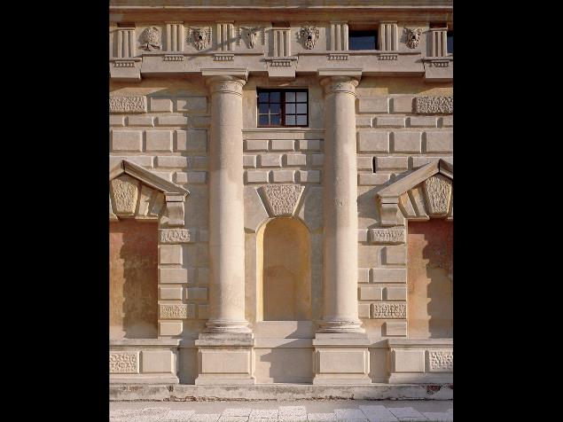
Giulio Romano. Courtyard of the Palazzo del Te, Mantua. ca. 1527–34

Slide 4
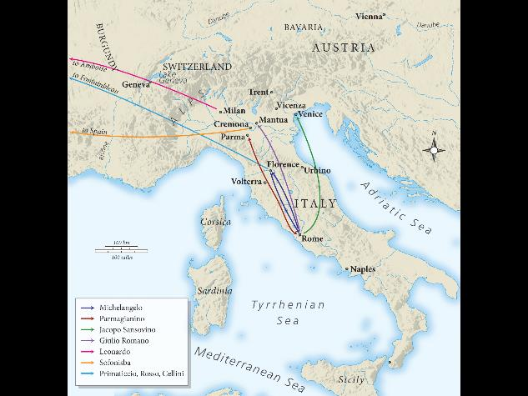
Travels of some artists in sixteenth-century Italy

Slide 5
Venice and the Veneto (5)
Titian
The Pesaro Madonna, commissioned for an altar, shows grandeur in its massive columns and marble staircase.
Colors were built up in layers of red, white, black, and yellow.
Intersecting diagonals in the composition reach from Jacopo Pesaro to the off-center Virgin.

Slide 6
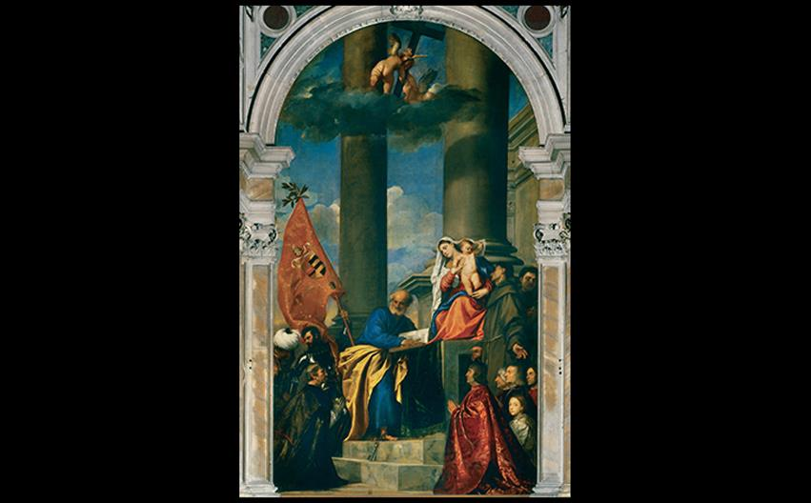
Titian PESARO MADONNA 1519–1526. Oil on canvas, 16' × 8'10" (4.9 × 2.7 m). Side-aisle altarpiece, Santa Maria Gloriosa dei Frari, Venice. © Cameraphoto Arte, Venice.
Notes:
Titian PESARO MADONNA 1519–1526. Oil on canvas, 16' × 8'10" (4.9 × 2.7 m). Side-aisle altarpiece, Santa Maria Gloriosa dei Frari, Venice. © Cameraphoto Arte, Venice.

Slide 7
Venice and the Veneto (6)
Titian
Isabella d'Este of Mantua became a true Renaissance woman, patronizing painters, musicians, writers, and collecting ancient art and objects.
Her portrait by Titian is a product of their long-standing professional relationship.

Slide 8
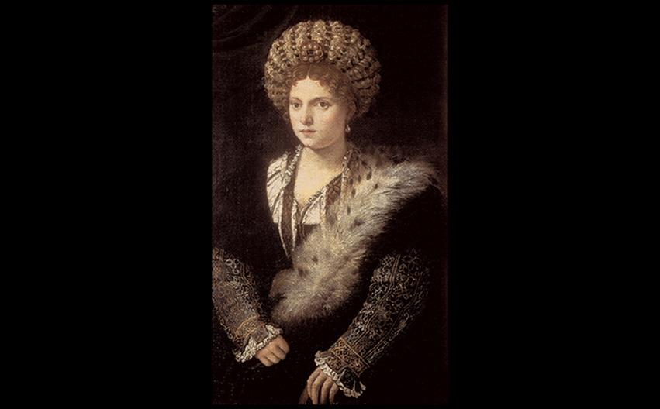
Titian ISABELLA D'ESTE 1534–1536. Oil on canvas, 40-1/8" × 25-3/16" (102 × 64.1 cm). Kunsthistorisches Museum, Vienna. © KHM-Museumsverband.
Notes:
Titian ISABELLA D'ESTE 1534–1536. Oil on canvas, 40-1/8" × 25-3/16" (102 × 64.1 cm). Kunsthistorisches Museum, Vienna. © KHM-Museumsverband.

Slide 9
Venice and the Veneto (7)
Titian
The "Venus" of Urbino, contrary to its stark female nudity, may have been a reference to marriage.
The cassoni in the background and sleeping dog (symbol for fidelity) reveal that the work may have been associated with Guidobaldo della Rovere's marriage.
Neither a goddess nor courtesan, the woman was possibly a wife.

Slide 10
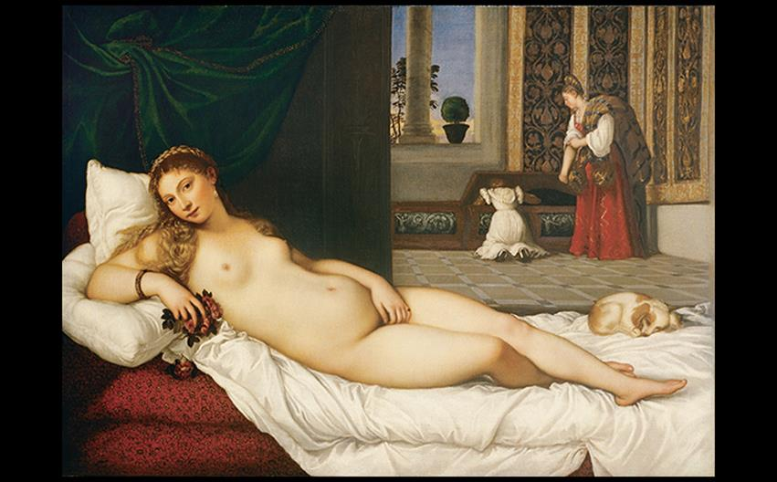
Titian "VENUS" OF URBINO c. 1538. Oil on canvas, 3'11" × 5'5" (1.19 × 1.65 m). Galleria degli Uffizi, Florence. © Studio Fotografico Quattrone, Florence.
Notes:
Titian "VENUS" OF URBINO c. 1538. Oil on canvas, 3'11" × 5'5" (1.19 × 1.65 m). Galleria degli Uffizi, Florence. © Studio Fotografico Quattrone, Florence

Slide 11
Venice and the Veneto (8)
Veronese and Tintoretto
Color, light, and expressively loose brushwork characterized Venetian painting.
One of Veronese's most famous works is a Last Supper, later renamed Feast in the House of Levi for its controversial content.

Slide 12
Venice and the Veneto (9)
Veronese and Tintoretto
Veronese shocked patrons with his painting later called Feast in the House of Levi.
The scene contained pageantry, scruffy dogs, and foreign soldiers, overall offending viewers and removing it from a typical Last Supper scene.
The Inquisition ordered an explanation and subsequent renaming.

Slide 13
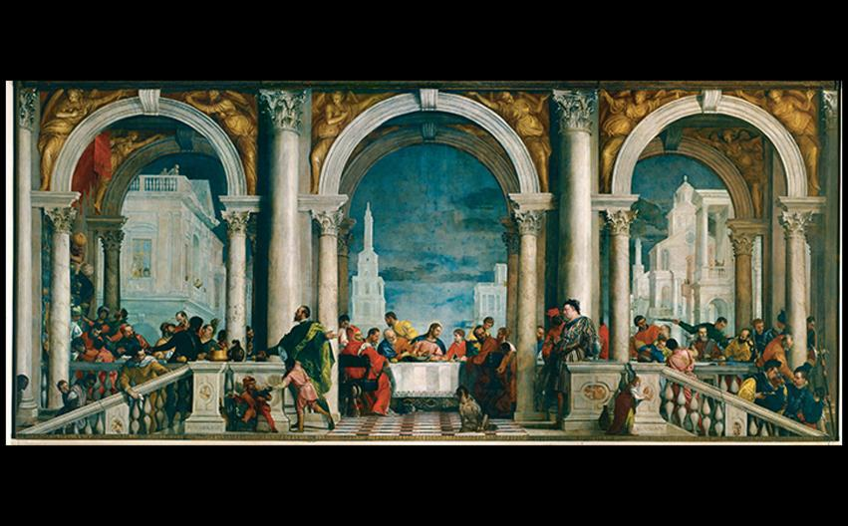
Veronese FEAST IN THE HOUSE OF LEVI From the refectory of the monastery of SS. Giovanni e Paolo, Venice. 1573. Oil on canvas, 18'3" × 42' (5.56 × 12.8 m). Galleria dell'Accademia, Venice. © Cameraphoto Arte, Venice.
Notes:
Veronese FEAST IN THE HOUSE OF LEVI From the refectory of the monastery of SS. Giovanni e Paolo, Venice. 1573. Oil on canvas, 18'3" × 42' (5.56 × 12.8 m). Galleria dell'Accademia, Venice. © Cameraphoto Arte, Venice.

Slide 14
Venice and the Veneto (10)
Veronese and Tintoretto
Tintoretto sought to combine Titian's coloring with the drawing of Michelangelo.
His The Last Supper differs from da Vinci's.
The scene is viewed from a corner and features two light sources.
The speed of his work was especially noted.

Slide 15
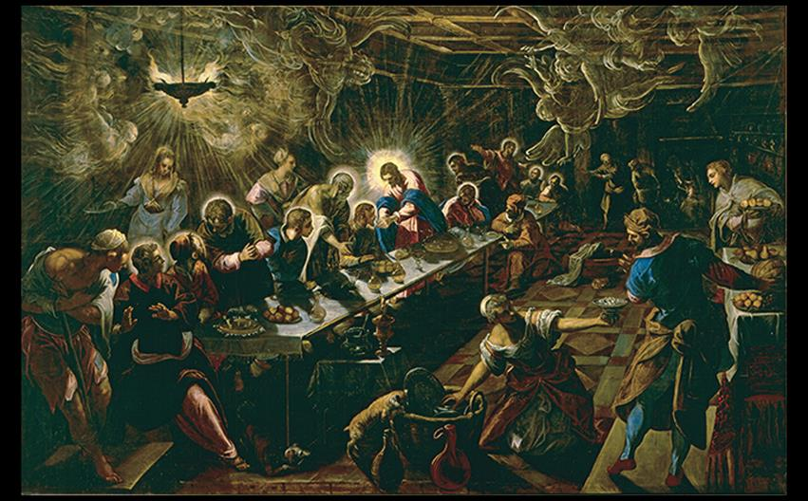
Tintoretto THE LAST SUPPER Church of San Giorgio Maggiore, Venice. 1592–1594. Oil on canvas, 12' × 18'8" (3.7 × 5.7 m). © Cameraphoto Arte, Venice.
Notes:
Tintoretto THE LAST SUPPER Church of San Giorgio Maggiore, Venice. 1592–1594. Oil on canvas, 12' × 18'8" (3.7 × 5.7 m). © Cameraphoto Arte, Venice.

Slide 16
The Architecture of Palladio (1 of 3)
Andrea Palladio dominated architecture with characteristics of harmonious symmetry and controlled ornamentation.
He became involved in publishing books on architecture that would become tenets for future architects.
Four Books of Architecture was a staple in the libraries of educated people.

Slide 17
The Architecture of Palladio (2 of 3)
San Giorgio Maggiore
This monastery church featured a variation on the traditional Renaissance façade for a basilica.
The interior includes finely balanced geometry, evidenced by engaged columns and short pilasters echoing the two levels of orders on the façade.

Slide 18
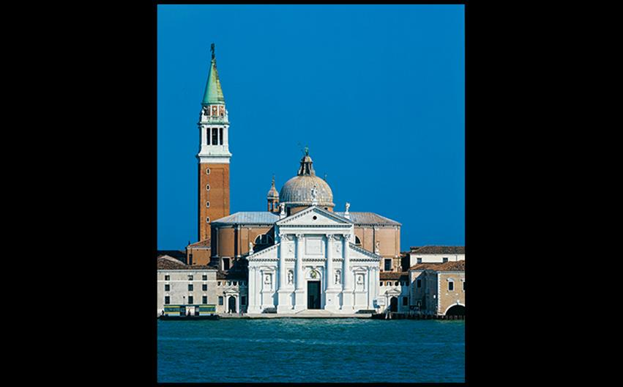
Palladio CHURCH OF SAN GIORGIO MAGGIORE, VENICE Plan 1565; construction 1565–1580; façade 1597–1610; campanile 1791. Finished by Vincenzo Scamozzi following Palladio's design. © Cameraphoto Arte, Venice.
Notes:
Palladio CHURCH OF SAN GIORGIO MAGGIORE, VENICE Plan 1565; construction 1565–1580; façade 1597–1610; campanile 1791. Finished by Vincenzo Scamozzi following Palladio's design. © Cameraphoto Arte, Venice.

Slide 19
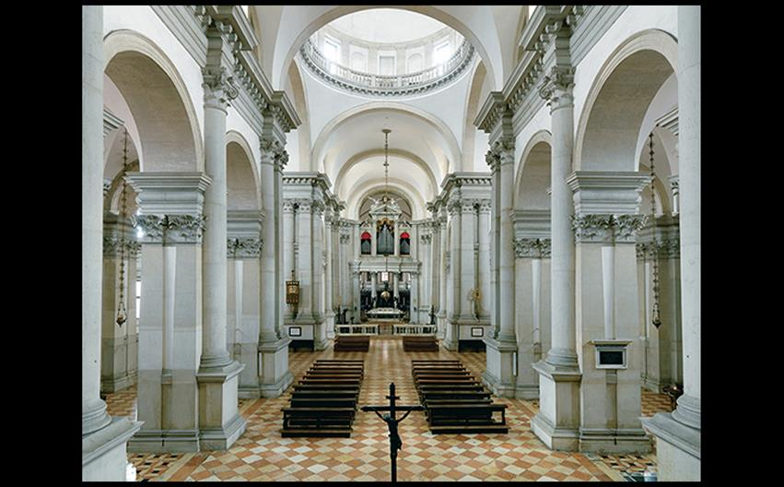
NAVE, CHURCH OF SAN GIORGIO MAGGIORE, VENICE Begun 1566. Tintoretto’s Last Supper (not visible) hangs to the left of the altar. © Cameraphoto Arte, Venice.
Notes:
NAVE, CHURCH OF SAN GIORGIO MAGGIORE, VENICE Begun 1566. Tintoretto’s Last Supper (not visible) hangs to the left of the altar. © Cameraphoto Arte, Venice.

Slide 20
The Architecture of Palladio (3 of 3)
The Villa Rotunda
This villa outside Vicenza was designed as a party house and meant to have a spectacular view of the countryside.
It secularized the dome.
Its plan consisted of a circle inscribed within symmetrical squares.

Slide 21
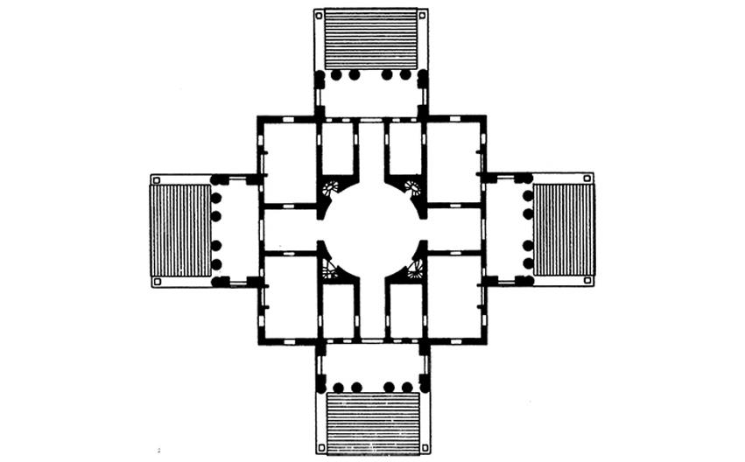
Palladio PLAN OF VILLA ROTONDA, VICENZA Italy. Begun 1560s.
Notes:
Palladio PLAN OF VILLA ROTONDA, VICENZA Italy. Begun 1560s.

Slide 22
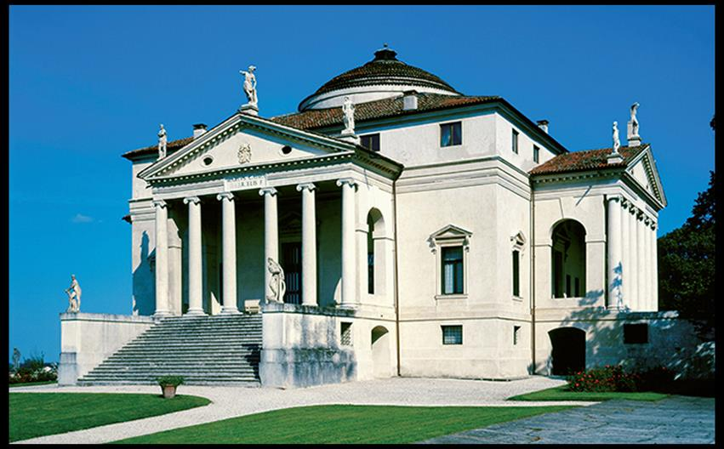
Palladio EXTERIOR VIEW OF VILLA ROTONDA, VICENZA After its purchase in 1591 by the Capra family, the Villa Rotonda became known as the Villa Capra. © Cameraphoto Arte, Venice.
Notes:
Palladio EXTERIOR VIEW OF VILLA ROTONDA, VICENZA After its purchase in 1591 by the Capra family, the Villa Rotonda became known as the Villa Capra. © Cameraphoto Arte, Venice.

Slide 23
Mannerism
This style developed into an anti-Classical movement in which artificiality, grace, and elegance took priority over lifelike references.
Patrons favored esoteric subjects.
Painters and sculptors quoted other works with self-conscious playfulness.
Architects used Classical orders in unconventional ways.

Slide 24
Pontormo, Parmigianino, and Bronzino (1 of 6)
This movement was characterized by artificiality, grace, and elegance over ordered balance.
Artists distorted conventions and created contrived, enigmatic forms.
Carucci's Deposition shows an ambiguous composition with a dreamy atmosphere and odd poses.
Jarring colors are juxtaposed.

Slide 25
Pontormo, Parmigianino, and Bronzino (2 of 6)
Painters created contrived compositions and irrational spatial environments, full of quoted references to predecessors' works.
Pontormo
Jacopo Carucci da Pontormo created frescoes for the Capponi Chapel.
Deposition's ambiguous composition gives a visionary feeling to the piece.

Slide 26
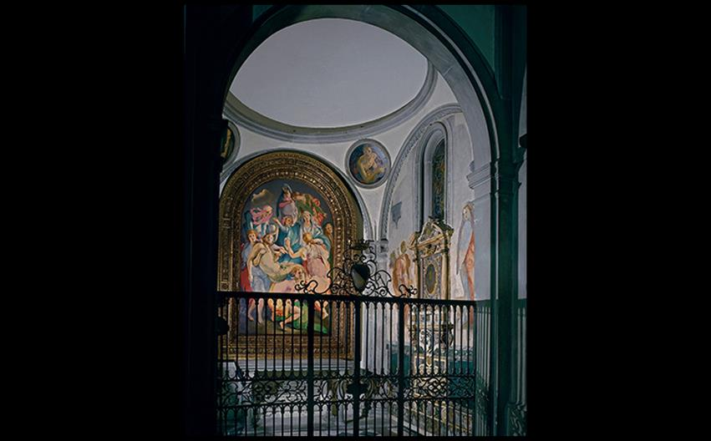
CAPPONI CHAPEL, CHURCH OF SANTA FELICITÀ, FLORENCE Chapel by Filippo Brunelleschi for the Barbadori family, 1419–1423; acquired by the Capponi family, who ordered paintings by Pontormo, 1525–1528. Index Ricerca Iconografica.
Notes:
CAPPONI CHAPEL, CHURCH OF SANTA FELICITÀ, FLORENCE Chapel by Filippo Brunelleschi for the Barbadori family, 1419–1423; acquired by the Capponi family, who ordered paintings by Pontormo, 1525–1528. Index Ricerca Iconografica.

Slide 27
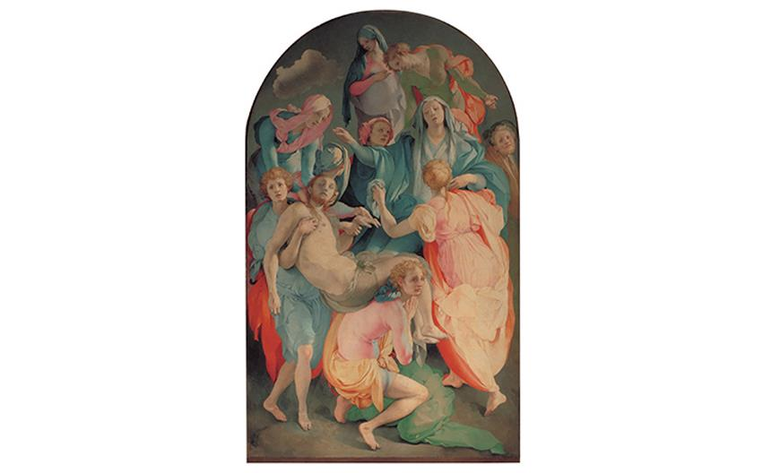
Pontormo DEPOSITION Altarpiece in Capponi Chapel, church of Santa Felicità, Florence. 1525–1528. Oil and tempera on wood panel, 10'3" × 6'4" (3.1 × 1.9 m). © Studio Fotografico Quattrone, Florence.
Notes:
Pontormo DEPOSITION Altarpiece in Capponi Chapel, church of Santa Felicità, Florence. 1525–1528. Oil and tempera on wood panel, 10'3" × 6'4" (3.1 × 1.9 m). © Studio Fotografico Quattrone, Florence

Slide 28
Pontormo, Parmigianino, and Bronzino (3 of 6)
Pontormo
Deposition's ambiguous composition gives a visionary feeling to the piece.
Some figures press into the viewer's space while others stand on tiptoe, creating odd poses.
The most striking oddity of this altarpiece is the choice of colors with bizarre juxtapositions.

Slide 29
Pontormo, Parmigianino, and Bronzino (4 of 6)
Parmigianino
Left unfinished at the time of the artist's early death is the Madonna of the Long Neck.
Mary's proportions are unnatural, with her massive legs contrasting narrow shoulders and long neck and fingers.
The well-known scene is presented in a manner intended to intrigue viewers.

Slide 30
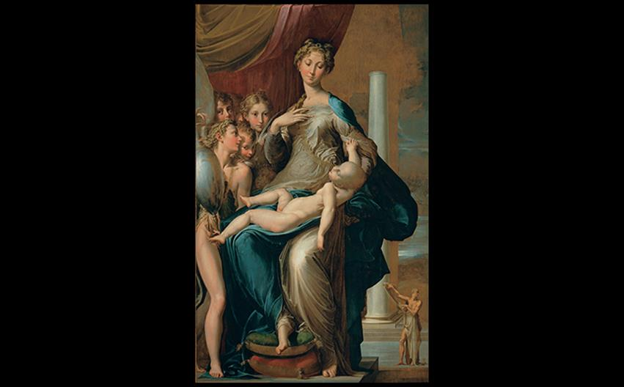
Parmigianino MADONNA OF THE LONG NECK 1534–1540. Oil on wood panel, 7'1" × 4'4" (2.16 × 1.32 m). Galleria degli Uffizi, Florence. © Studio Fotografico Quattrone, Florence.
Notes:
Parmigianino MADONNA OF THE LONG NECK 1534–1540. Oil on wood panel, 7'1" × 4'4" (2.16 × 1.32 m). Galleria degli Uffizi, Florence. © Studio Fotografico Quattrone, Florence.

Slide 31
Pontormo, Parmigianino, and Bronzino (5 of 6)
Bronzino
The portrait of Eleonora of Toledo shows the mother and her second son in a haughty, self-assured way.
It is an embodiment of dynastic power and an assurance of Medici succession.

Slide 32
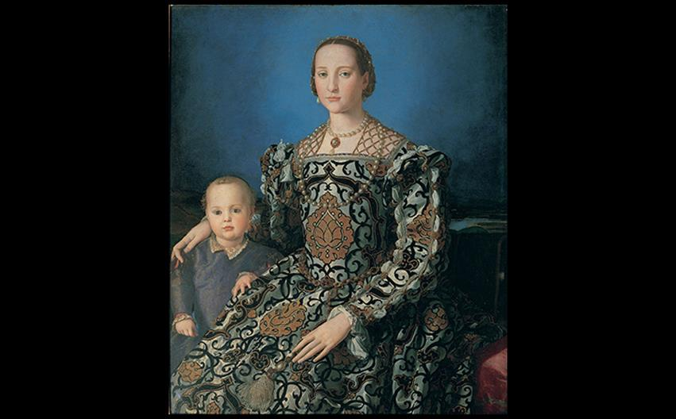
Bronzino PORTRAIT OF ELEONORA OF TOLEDO AND HER SON GIOVANNI DE' MEDICI 1545. Oil on wood panel, 45-1/4 × 37-3/4" (115 × 96 cm). Galleria degli Uffizi, Florence. © Studio Fotografico Quattrone, Florence.
Notes:
Bronzino PORTRAIT OF ELEONORA OF TOLEDO AND HER SON GIOVANNI DE' MEDICI 1545. Oil on wood panel, 45-1/4 × 37-3/4" (115 × 96 cm). Galleria degli Uffizi, Florence. © Studio Fotografico Quattrone, Florence.

Slide 33
Pontormo, Parmigianino, and Bronzino (6 of 6)
Bronzino
Bronzino's Allegory with Venus and Cupid is one of the strangest paintings of the sixteenth century.
Complex interweaving of seven figures, three masks, and a dove press into the foreground.
Venus and her son Cupid engage in unsettlingly erotic actions while Chronos pulls back a curtain to expose them.

Slide 34
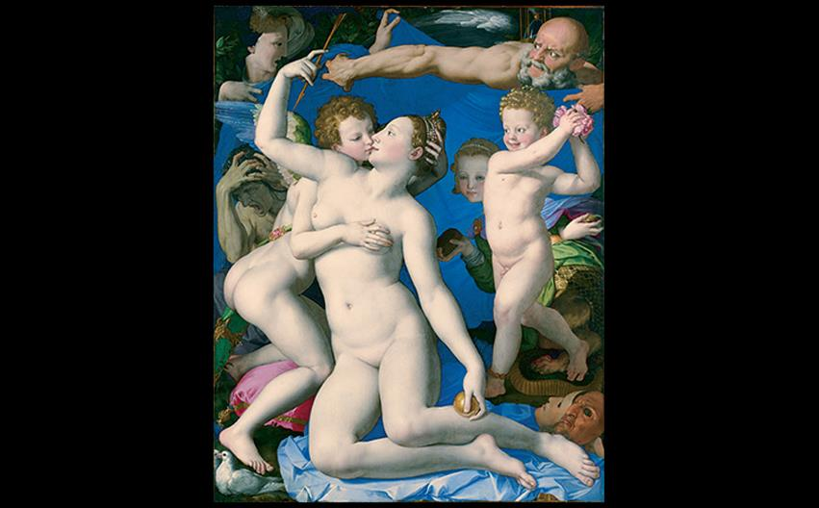
Bronzino ALLEGORY WITH VENUS AND CUPID Mid 1540s. Oil on panel, 57-1/2 × 46" (1.46 × 1.16 m). National Gallery, London. © 2016. Copyright The National Gallery, London/Scala, Florence.
Notes:
Bronzino ALLEGORY WITH VENUS AND CUPID Mid 1540s. Oil on panel, 57-1/2 × 46" (1.46 × 1.16 m). National Gallery, London. © 2016. Copyright The National Gallery, London/Scala, Florence.

Slide 35
Anguissola and Fontana (1 of 2)
Sofonisba Anguissola (c. 1532–1625) was a skilled miniaturist.
She worked as court painter to the queen of Spain from 1560, but her works were lost in a palace fire.
Anthony van Dyck sketched her portrait in 1624 when she was 96 years old.

Slide 36
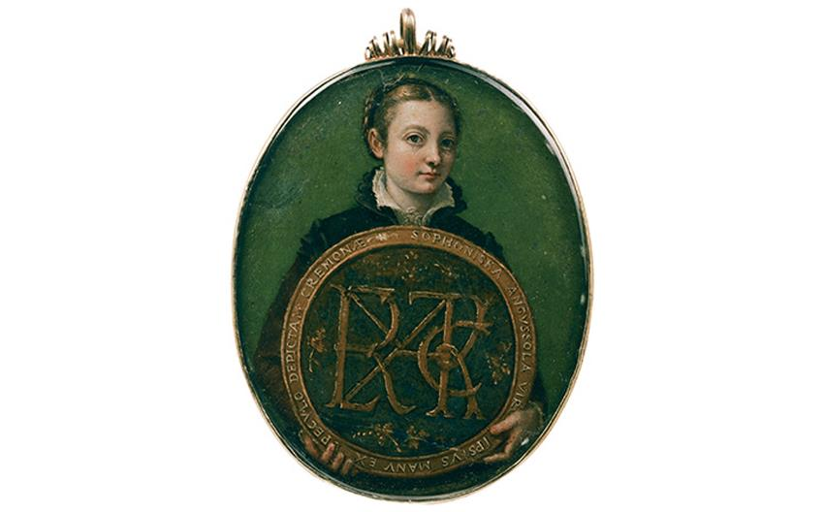
Sofonisba Anguissola SELF-PORTRAIT c. 1556. Varnished watercolor on parchment, 3-1/4" × 2-1/2" (8.3 × 6.4 cm). Museum of Fine Arts, Boston. Emma F. Munroe Fund 60.155. Photograph © 2017 Museum of Fine Arts, Boston.
Notes:
Sofonisba Anguissola SELF-PORTRAIT c. 1556. Varnished watercolor on parchment, 3-1/4" × 2-1/2" (8.3 × 6.4 cm). Museum of Fine Arts, Boston. Emma F. Munroe Fund 60.155. Photograph © 2017 Museum of Fine Arts, Boston.

Slide 37
Anguissola and Fontana (2 of 2)
Lavinia Fontana (1552–1614) found a successful career in Bologna that would later boast her to position of papal court painter in 1603.
Noli Me Tangere shows Christ revealing himself to Mary Magdalen following his resurrection.
Its unsettling diagonal plunge into depth is characteristic of the Mannerist style.

Slide 38
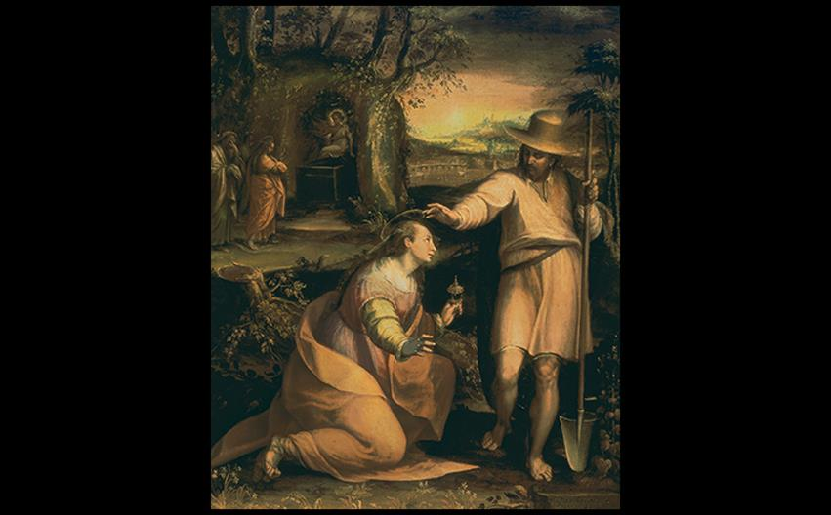
Lavinia Fontana NOLI ME TANGERE 1581. Oil on canvas, 47-3/8" × 36-5/8" (120.3 × 93 cm). Galleria degli Uffizi, Florence. Canali Photobank, Milan, Italy.
Notes:
Lavinia Fontana NOLI ME TANGERE 1581. Oil on canvas, 47-3/8" × 36-5/8" (120.3 × 93 cm). Galleria degli Uffizi, Florence. Canali Photobank, Milan, Italy.

Slide 39
Sculpture (1 of 2)
Mannerist sculpture stylizes body forms and foregrounds.
Cellini
At Fontainebleau, Benvenuto Cellini created the Salt-Cellar of King Francis I.
Figures representing the land and the sea lean back at impossible angles.

Slide 40
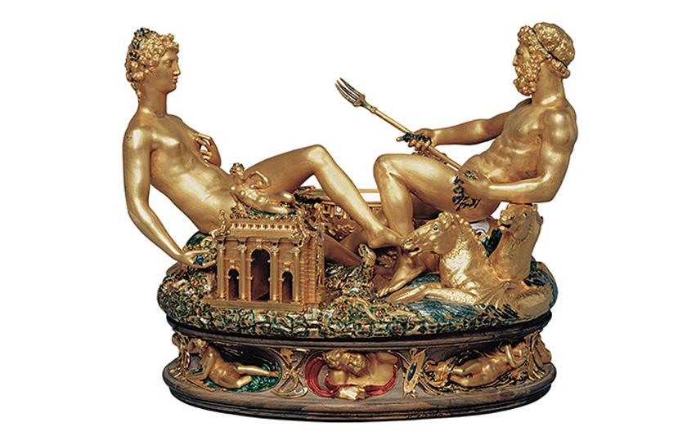
Benvenuto Cellini SALTCELLAR OF KING FRANCIS I OF FRANCE 1540–1543. Gold and enamel, 10-1/2" × 13-1/8" (26.67 × 33.34 cm). Kunsthistorisches Museum, Vienna. © KHM-Museumsverband.
Notes:
Benvenuto Cellini SALTCELLAR OF KING FRANCIS I OF FRANCE 1540–1543. Gold and enamel, 10-1/2" × 13-1/8" (26.67 × 33.34 cm). Kunsthistorisches Museum, Vienna. © KHM-Museumsverband.

Slide 41
Sculpture (2 of 2)
Giambologna
Sculptor Giambologna's artistic output included fountains and works in bronze.
The Capture of a Sabine Woman is his most famous sculpture.
This piece was carved from a single block of marble despite its deep undercutting and projecting gestures.

Slide 42
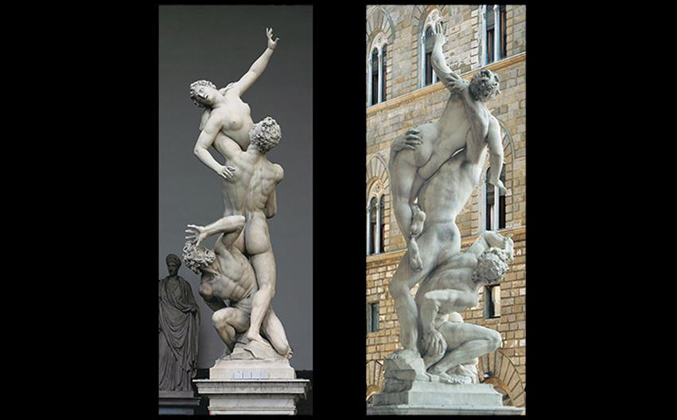
Giambologna THE CAPTURE OF A SABINE WOMAN 1581–1582. Marble, height 13'6" (4.1 m). Loggia dei Lanzi, Florence. © Studio Fotografico Quattrone, Florence.
Notes:
Giambologna THE CAPTURE OF A SABINE WOMAN 1581–1582. Marble, height 13'6" (4.1 m). Loggia dei Lanzi, Florence. © Studio Fotografico Quattrone, Florence.

Slide 43
Art and the Counter-Reformation
Paul III was the first pope to pursue Church reform in response to Protestantism.
He founded the Inquisition, an office that sought out heretics.
Art became a powerful weapon of propaganda, especially in the Society of Jesus founded by Ignatius of Loyola.

Slide 44
Rome and the Vatican (1 of 3)
Paul III commissioned Michelangelo for the Sistine Chapel on Capitoline Hill.
Michelangelo's Late Work
The Last Judgment scene abandoned medieval conception and showed a swarm of resurrected humans pushing upward.
On the right, the damned are plunged into hell.

Slide 45
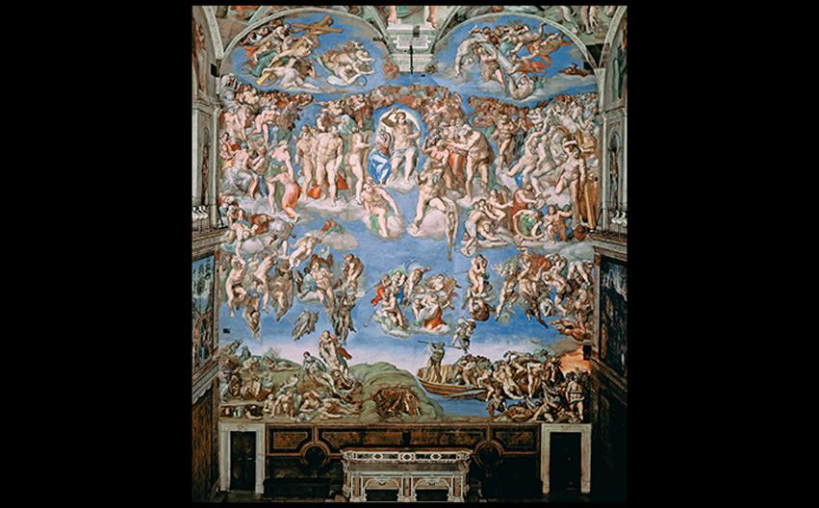
Michelangelo LAST JUDGMENT, SISTINE CHAPEL 1536–1541. Fresco, 48 × 44' (14.6 × 13.4 m). Photo: Vatican Museums/IKONA.
Notes:
Michelangelo LAST JUDGMENT, SISTINE CHAPEL 1536–1541. Fresco, 48 × 44' (14.6 × 13.4 m). Photo: Vatican Museums/IKONA.

Slide 46
Rome and the Vatican (2 of 3)
Michelangelo's Late Work
The completion of St. Peter's Basilica also fell to Michelangelo.
He undid parts of Sangallo's design in order to strengthen Bramante's central plan.
Three surviving hemicycles show his work, and the current dome retains his basic design.

Slide 47
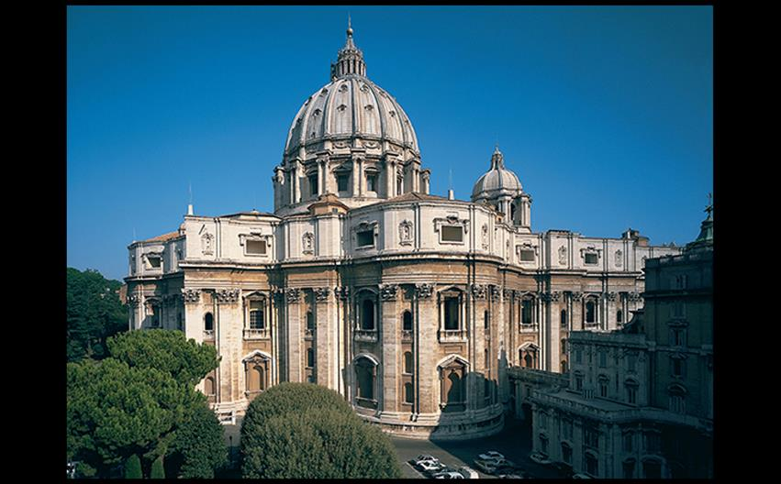
Michelangelo ST. PETER'S BASILICA, VATICAN c. 1546–1564; dome completed 1590 by Giacomo della Porta; lantern 1590–1593. View from the west. © James Morris, Ceredigion.
Notes:
Michelangelo ST. PETER'S BASILICA, VATICAN c. 1546–1564; dome completed 1590 by Giacomo della Porta; lantern 1590–1593. View from the west. © James Morris, Ceredigion.

Slide 48
Art and Its Contexts: St. Peter's Basilica
Donato Bramante undertook the task of rebuilding St. Peter's Basilica.
It was built with a central plan, possibly referring to the tradition of Christian martyria.
Ultimately, Michelangelo transformed St. Peter's into a building of magnificent proportion.
Hemicycles and blind windows remain today from his design.

Slide 49
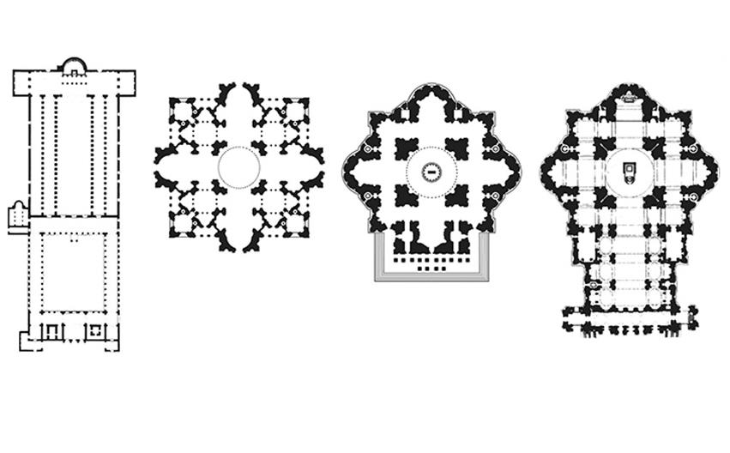
ART AND ITS CONTEXTS: St. Peter's Basilica
Notes:
ART AND ITS CONTEXTS: St. Peter's Basilica

Slide 50
Rome and the Vatican (3 of 3)
Vignola
Ignatius of Loyola commissioned Il Gesù to be the Jesuit headquarters in Rome.
Vignola designed it with a wide, barrel-vaulted nave and no aisles.
The symmetrical façade emphasized a central portal with Classical pilasters, engaged columns, and volutes linking the tall section with lower sides.

Slide 51
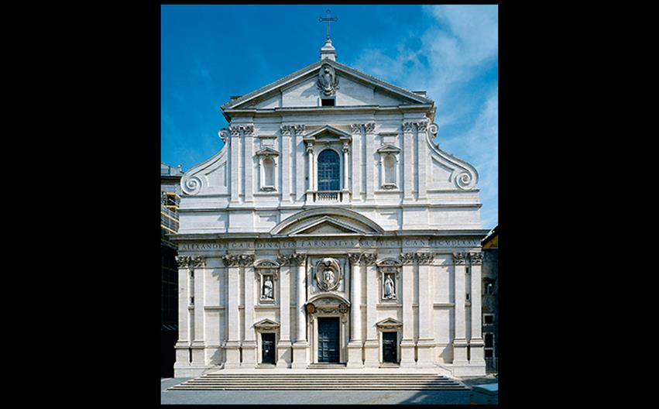
Vignola and Giacomo della Porta FAÇADE OF THE CHURCH OF IL GESÙ, ROME c. 1568–1584. © 2016. Photo Scala, Florence.
Notes:
Vignola and Giacomo della Porta FAÇADE OF THE CHURCH OF IL GESÙ, ROME c. 1568–1584. © 2016. Photo Scala, Florence.

Slide 52
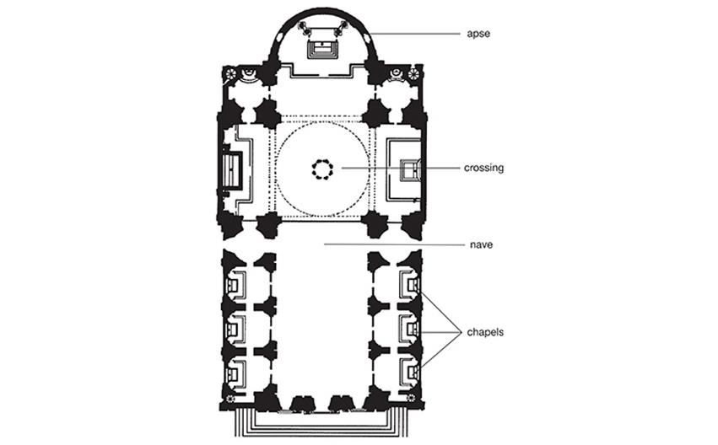
Vignola and Giacomo della Porta PLAN OF THE CHURCH OF IL GESÙ, ROME c. 1568–1584.
Notes:
Vignola and Giacomo della Porta PLAN OF THE CHURCH OF IL GESÙ, ROME c. 1568–1584.

